Slide 1
Retirement Age and Inequality
Ken Jacobs
UC Berkeley Center for Labor Research and Education
February 2012

Slide 2
The factors effecting employees ability to stay in the workforce vary greatly for differing groups of workers.
Improvements in health, workplace conditions, and longevity may allow most people to work longer, but many workers have not shared in these gains.
Workers without a college degree enter the workforce earlier and leave the workforce earlier than college educated workers.
Economically vulnerable workers are more likely to have health challenges that will make working longer difficult.
While labor force participation among older workers is growing, even older workers who are physically able to work longer may be unable to find jobs.
Sources: GAO Report to the Chairman, Special Committee on Aging, U.S. Senate,
“Raising the Retirement Ages Would Have Implications for Older Workers and SSA Disability Rolls,” 2010
Theresa Ghilarducci, “When I’m Sixty-Four,” 2008.

Slide 3
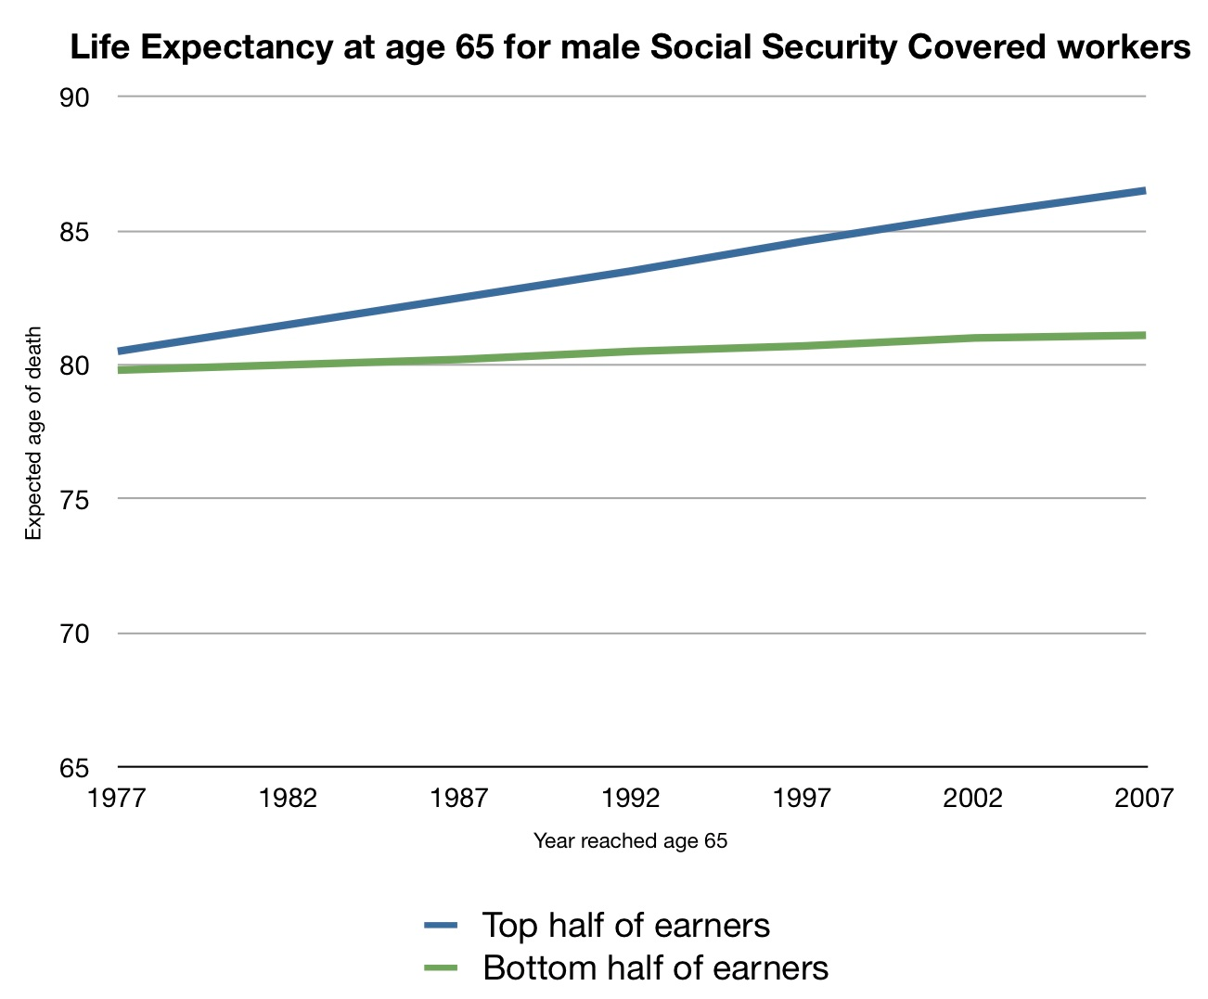
Gains in life expectancy for retirement age men since 1977 have been concentrated in the top half of the income spectrum.
http://theincidentaleconomist.com/wordpress/
Notes:
5.5 year increase vs. 1 year.

Slide 4
Life expectance varies significantly by race, ethnicity and socio-economic status.
Clarke and Harrati, “Life Expectancy in California’s Diverse Population,” 2011

Slide 5
Health Is a Key Factor in Retirement Decision for Many Workers
41 percent of retirees leave the workforce earlier than planned, and among these 54 percent did so for health or disability reasons. (EBRI, 2010 Retirement Confidence Survey)
The majority of early retirees are in poor health and have higher mortality risk than age 65 retirees. (Social Security Administration Office of Policy)
29 percent of all men who claim Social Security retirement benefits at 62 report being in poor or fair health, whereas only 12 percent of men who claim at a later age report poor or fair health. (Boston College Center for Retirement Research)
Sources: GAO Report to the Chairman, Special Committee on Aging, U.S. Senate,
“Raising the Retirement Ages Would Have Implications for Older Workers and SSA Disability Rolls,” 2010
Hilary Waldron, “Heterogeneity and Mortality Risk among Early Retiree Men, SSA ORES, May 2004

Slide 6
Many Workers Age 60-67 Face Health and Physical Challenges to Working Longer
Among adults who were 60-67 years old in California in 2009:
49.1 percent were working for pay, 40.1 percent full time.
22 percent reported being in fair or poor health.
Individuals not in the workforce were twice as likely to report being in fair or poor healthy as those who were working.
36.8 percent reported disability status due to physical, mental or emotional condition.
Source: 2009 California Health Interview Survey

Slide 7
There are significant health disparities by race and ethnicity.
Californians age 60-67 in less than good health by work status, race and ethnicity
Percent reporting health status as fair or poor
Source: California Health Interview Survey 2009

Slide 8
Disability Affecting Work in California by Age and Educational Attainment
Source: Current Population Survey 2001-2011

Slide 9
Even when older workers are healthy and willing, they may not be able to find work.
Workers over age 55 are slightly less likely than younger workers to lose a job.
However, if they lose a job, they are less likely to find employment.
57 percent of older workers who lose their jobs retire, partially or fully, following a job loss.
Source: GAO Report to the Chairman, Special Committee on Aging, U.S. Senate,
“Raising the Retirement Ages Would Have Implications for Older Workers and SSA Disability Rolls,” 2010

Slide 10
Older workers are more likely to be unemployed long-term after they lose a job.
Unemployed for one year or more by age, US 2009-2011
Source: Current Population Survey, 2009-20011

Slide 11
Conclusion
Lower wage workers have not shared equally in life expectancy gains.
There are large differences in life expectancy by education, race and ethnicity.
Many workers will not be able to stay in the labor market due to health challenges and the physical demands of the job.
Outside employment may not be available for those who cannot continue in their current job.
An increase in the retirement age would have disparate impacts on different workers and workforces.

