Slide 1
CalPERS Long-Term Care Program Update Presented to California State Legislature March 15, 2013

Slide 2
Background – CalPERS Long-Term Care (LTC)
Legislation
1991 – Initial legislation established
1995 – First policies issued
Program
Guaranteed renewable
Inflation protection
CalPERS employees, retirees, members and their family members: spouses, adult siblings, parents, parents-in-law
Open to all public employee groups
Not limited to those that contract with CalPERS

Slide 3
Summary of CalPERS LTC Programs
As of 6/30/2012 |  |  |  | Average Premium
LTC1 | Comprehensive/Facility Only | Members | 119,841
 | Unlimited, 6-year, and 3-year | Annualized Premium | $ 266,614,497 | $2,225
 | Partnership | Members | 5,416
 | 2-year, 1-year, and 6-months | Annualized Premium | $ 7,745,079 | $1,430
LTC2 | Comprehensive/Facility Only | Members | 8,611
 | Unlimited, 6-year, and 3-year | Annualized Premium | $ 20,896,311 | $2,427
 | Partnership | Members | 272
 | 2-year, 1-year, and 6-months | Annualized Premium | $ 479,489 | $1,763
LTC3 | Comprehensive/Facility Only | Members | 16,085
 | Unlimited, 6-year, and 3-year | Annualized Premium | $ 32,151,457 | $1,999
 | Partnership | Members | 105
 | 2-year and 1-year | Annualized Premium | $ 213,296 | $2,031
Total | All | Members | 150,330
 |  | Annualized Premium | $ 328,100,129 | $2,183

Slide 4
LTC Program Update (As of December 31, 2012)
Program Statistics
148,292 active program members
Over $327 million in annual premium
$2,206 average annualized premium
Invested asset value of $3.6 billion

Slide 5
LTC Program Update (As of December 31, 2012)
Claim and Care Management
5,632 members in active claim
90,300+ volume of claim payments annually
$179+ million paid in member benefits annually
$1+ billion paid in member benefits*
95% of claims paid in 10 days
* Since program inception

Slide 6
Recovery From Claim
Recovery continues throughout the life of a claim
Almost 30% of closed claimants have recovered
58% before benefit payments are made
42% after benefit payments have begun
Claim Approved
Claim Paid
28% Remain in Claim
58% Recover
before Benefits Paid
42% Recover
after Payment Begins

Slide 7
Claims Management Overview
CalPERS LTC provides substantial value to its members
Over 15,000 members have received LTC benefits since program inception
CalPERS LTC claimants most common disabling diagnoses
Dementia, cancer, stroke, fractures, Parkinson’s
11% cognitive impairment
67% 2+ activities of daily living deficits
22% combined cognitive impairment AND 2+ activities of daily living deficits

Slide 8
Clinical Profile of Claims – Since inception of LTC Program
Disabling Condition | % of Total Approved Claims | % of Total Paid Claims | Total Paid Claims
Pure Dementia | 31% | 31% | $297,241,961
Stroke | 13% | 13% | $126,832,831
Fractures/Injuries | 9% | 6% | $60,361,987
Parkinson’s Disease | 8% | 6% | $54,682,200
Arthritis, Rheumatic Disease | 7% | 5% | $48,899,817
Cancer | 18% | 4% | $34,126,791
Cardiomyopathy, CHF | 4% | 3% | $26,342,978
Disorders of the Spine | 3% | 3% | $26,194,681
Respiratory Diseases | 5% | 2% | $23,447,023
Dementia – falls, fractures or injury | 2% | 2% | $22,934,826

Slide 9
Profile of Those Who Recover
Women claimants lead in recovery
Total recovered claimants | 4,208
Female | 68%
Male | 32%
Average age
At claim | 75.7
At recovery | 76.5
Age at recovery
Age 65 and under | 12%
Age 66 and older | 88%
Age 85+ years at recovery | 19%

Slide 10
Clinical Profile of Those Who Recover
Claimants with fractures and injuries have the highest recovery rate
Disabling Condition | % of all Recoveries
Fractures and Injuries | 17%
Stroke | 11%
Cancer | 10%
Pure Dementia | 9%
Arthritis, Rheumatic Disease | 6%
Disorders of the Spine | 5%
Respiratory Disease | 4%
Cardiomyopathy, CHF | 3%
Parkinson’s Disease | 3%
Orthopedic Complications | 2%

Slide 11
Claimants Paid by Service Type January – December 2012
Alternative Living Facilities* (ALF) account for the highest number of paid claims
2012 Quarterly Claims Paid by Service Type
 | Nursing Home | Home Health Care | Alternative Living Facility | Respite | Other Benefits | Total
1st Quarter | 1,884 | 5,746 | 6,367 | 202 | 133 | 14,332
2nd Quarter | 1,739 | 5,894 | 6,406 | 195 | 140 | 14,374
3rd Quarter | 1,819 | 6,042 | 6,569 | 238 | 137 | 14,805
4th Quarter | 1,901 | 6,123 | 6,909 | 196 | 158 | 15,287
Grand Total | 7,343 | 23,805 | 26,251 | 831 | 568 | 58,798
*ALFs include: Residential Care Facilities, Group Homes, Adult Foster Homes among others.

Slide 12
Claim Dollars Paid by Service Type January – December 2012
Alternative Living Facilities* (ALF) account for the highest paid dollar amount
2012 Quarterly Claims Paid by Service Type
 | Nursing Home | Home Health Care | Alternative Living Facility | Respite | Other Benefits | Total
1st Quarter | $8,581,958 | $13,441,661 | $21,634,860 | $688,163 | $110,358 | $44,457,000
2nd Quarter | $8,026,253 | $12,488,417 | $21,402,306 | $631,857 | $118,652 | $42,667,484
3rd Quarter | $8,448,652 | $13,674,068 | $23,322,565 | $519,795 | $131,886 | $46,096,966
4th Quarter | $8,716,191 | $14,741,466 | $24,633,289 | $601,328 | $139,142 | $48,831,416
Grand Total | $33,773,054 | $54,345,612 | $90,993,020 | $2,441,143 | $500,038 | $182,052,866
*ALFs include: Residential Care Facilities, Group Homes, Adult Foster Homes among others.

Slide 13
Average Time on Claim
Recovery – 9 Months
Death – 17.7 Months

Slide 14
CalPERS LTC1 Plan Membership
Total LTC1 Membership =125,257

Slide 15
The Funding Challenge Is Not Unique
Similar to other LTC insurance companies, the CalPERS LTC Program has experienced:
Worse-than-expected morbidity (i.e., claims), due in part to less stringent underwriting standards in the mid-1990’s
Higher-than-expected claims incidence
Lower-than-expected investment income

Slide 16
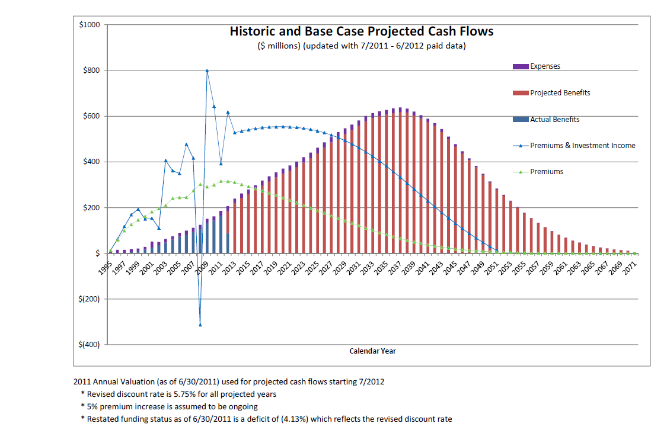
Fund Cash Flow Projections

Slide 17
Rate Increases by Plan Type
 | 2003 Rate Increases by Plan and Age (LTC1 only)
Plan | Age 35 | Age 45 | Age 50 | Age 55 | Age 60 | Age 65 | Age 70 | Age 75
Comprehensive lifetime inflation | 30.0% | 30.0% | 30.0% | 30.0% | 22.5% | 16.0% | 10.5% | 6.0%
Comprehensive 3 -year inflation | 30.0% | 24.0% | 22.3% | 20.0% | 15.0% | 10.0% | 7.3% | 6.0%
Comprehensive without Inflation | 10.0% | 10.0% | 10.0% | 10.0% | 8.0% | 6.0% | 6.0% | 6.0%
Facility with Inflation | 30.0% | 30.0% | 30.0% | 30.0% | 30.0% | 30.0% | 25.5% | 20.0%
Facility without Inflation | 13.0% | 13.0% | 13.0% | 13.0% | 13.0% | 13.0% | 9.5% | 6.0%
Partnership | 6.0% | 6.0% | 6.0% | 6.0% | 6.0% | 6.0% | 6.0% | 6.0%
 | 2007 Rate Increases by Plan and Age (LTC1 and LTC2)
Plan Comprehensive and Facility | Age 35 | Age 45 | Age 50 | Age 55 | Age 60 | Age 65 | Age 70 | Age 75
Lifetime coverage | 47.1% | 47.1% | 47.1% | 42.4% | 37.6% | 37.6% | 32.9% | 28.2%
Three-year with inflation | 16.5% | 16.5% | 16.5% | 16.5% | 16.5% | 16.5% | 16.5% | 16.5%
Three-year without Inflation | 5.0% | 5.0% | 5.0% | 5.0% | 5.0% | 5.0% | 5.0% | 5.0%
Partnership 2-year | 16.5% | 16.5% | 16.5% | 16.5% | 16.5% | 16.5% | 16.5% | 16.5%
Partnership 1-year | 5.0% | 5.0% | 5.0% | 5.0% | 5.0% | 5.0% | 5.0% | 5.0%
 | 2010 Rate Increases by Plan (All Plans)
Plan Comprehensive and Facility | All Ages
LTC1 and LTC2 Lifetime without inflation and all Inflation Coverage | 22.0%
LTC1 and LTC2 non-inflation and limited benefits (non-lifetime) and all LTC3 | 15.0%

Slide 18
Board-Approved Alternatives
Retained inflation
Open to all plans with inflation protection (excluding Partnership Plans)
Combined 10-Year/Retained inflation benefit
Open to those with Lifetime coverage and inflation protection
Daily benefit buy-up option
Offered periodically

Slide 19
LTC1 Monthly Premium Scenarios
Migration to 10-year and Retained Inflation in 2013
LTC1*
Issue Age In 1999 | Current Age in 2011 | Beginning Premium | Aggregate Premium After 5% Increases Migration to 10-year and Retained Inflation in 2013
 |  | LTC1 2010 | LTC12011 | LTC1 2012 | LTC1 2013 | LTC1 2014
38 | 50 | $98 | $103 | $108 | $71 | $71
 |  |  | $5 | $5 | -$37
48 | 60 | $158 | $166 | $174 | $118 | $118
 |  |  | $8 | $8 | -$56
58 | 70 | $248 | $260 | $273 | $259 | $259
 |  |  | $12 | $13 | -$14
* Monthly premium scenario is provided as illustrative example of the expected premiums for members who move from the LTC1 lifetime policy type to the 10-year policy with Retained Inflation. Exact premium amounts will vary by member due to issue age and attained age at the time the member elects to change coverage.

Slide 20
LTC2 Monthly Premium Scenarios
Migration to 10-year and Retained Inflation in 2013
 |  |  | LTC2*
Issue Age In 2004 | Current Age In 2011 | Beginning Premium | 5% Increases – Not Applicable to LTC2 Migration to 10-year and Retained Inflation in 2013
 |  | LTC2 2010 | LTC2 2011 |  | LTC2 2012 |  | LTC2 2013 | LTC2 2014
43 | 50 | $134 | $134 |  | $134 |  | $69 | $69
 |  |  |  |  |  |  | -$65
53 | 60 | $219 | $219 |  | $219 |  | $112 | $112
 |  |  |  |  |  |  | -$107
63 | 70 | $345 | $345 |  | $345 |  | $308 | $308
 |  |  |  |  |  |  | -$37
* Monthly premium scenario is provided as illustrative example of the expected premiums for members who move from the LTC2 lifetime policy type to the 10-year policy with Retained Inflation. Exact premium amounts will vary by member due to issue age and attained age at the time the member elects to change coverage.

Slide 21
Questions?

